Slide 1
ER Diagram Resources

Slide 2
Attributes, Entity Set, Relationship Set
Examples
Attributes (with attribute line)
Entity Sets
Relationship Sets (note, you can edit the name separately from the shape)
Identity Attribute
Entity Set Name
Attribute Name
Identity Attribute
Attribute Name
Weak Entity Set Name
Identity Attribute
Attribute Name
Entity Set Name
Weak Entity Set Name
Relationship
Set Name
ID
Relationship

Slide 3










Relationship Constraints
Use only the arrows
Use for roles
$ENT$
$REL$
Role1
$ENT$
$REL$
$ENT$
$REL$
Role2
$ENT$
$REL$
$ENT$
$REL$

Slide 4



IS-A Hierarchy
Our standard usage
Generalised
ISA
$\text{Specialise}{\text{d}}_{1}$
$…$
$\text{Specialise}{\text{d}}_{n}$

Slide 5
IS-A Hierarchy
Non-standard usage, can use for project, but we will not ask this
Overlap Constraint | Covering Constraint
 | false | true
false
true
Generalised
Generalised
ISA
ISA
Generalised
Generalised
ISA
ISA

Slide 6





Aggregation
Aggregation is the box surrounding REL_A
$ENT_{1}$
$REL_{A}$
$ENT_{3}$
$REL$
$ENT_{1}$

Slide 7
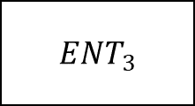
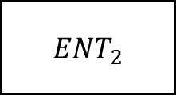



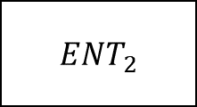

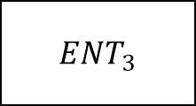








Example of Ternary Relationship
$ENT_{2}$
$ENT_{2}$
$ENT_{1}$
$REL$
$ENT_{3}$
$ENT_{1}$
$REL$
$ENT_{3}$
$ENT_{2}$
$ENT_{2}$
$ENT_{1}$
$REL$
$ENT_{3}$
$ENT_{1}$
$REL$
$ENT_{3}$

Slide 8



Example of Weak Entity Sets
Remember, the key in weak entity sets are partial key
$ENT$
$ID$
$ENT_{w}$

Slide 9







Employee ID
Email Address
Resignation Date
Department ID
Employee
name
Employees
$Belongs$
Departments
Contact Number
Department
name
ISA
$Participates$
Floor Number
Bookers
$Books$
Room Number
$$Juniors$$
Meeting Rooms
Name
ISA
$Approves$
Capacity
$Senior$s
$Manager$s

Slide 10







Email Address
Department ID
Resignation Date
Employee ID
Department
name
$Belongs$
Departments
Employee
name
Employees
Employee ID
Contact Number
Date
$submits$
ISA
$$Health$$
$$Declarations$$
Temperature
$Participates$
$$Juniors$$
Meeting Bookers
Date
Floor Number
$Books$
Start Time
Room Number
ISA
Meeting Rooms
Room
Name
$Senior$s
$Manager$s
$Approves$
Capacity

Slide 11


Email Address
Department ID
Employee ID
Resignation Date
Employee
name
Employees
$Belongs$
Departments
Department
name
Contact Number
ISA
$submits$
Employee ID
Date
$$Juniors$$
Meeting Bookers
$$Health$$
$$Declarations$$
Temperature
ISA
$Senior$s
$Manager$s

Slide 12





Employees
Date
$Participates$
Start Time
ISA
Floor Number
Bookers
$Books$
Room Number
Meeting Rooms
Room
Name
ISA
$Approves$
Capacity
$Senior$s
$Manager$s

Slide 13

Employee ID
Date
Employees
$$Health$$
$$Declarations$$
Temperature

Slide 14




$$Bookers$$
Meeting Room
$Books$
Date
StartTime
$$Employees$$
$$Health$$
$$Declarations$$

